Slide 1
EHEA Work Programme 2024-2027
EHEA: Transforming Education Together
Daniela Cristina Ghițulică, BFUG Vice-chair
EQAR Members’ Dialogue, online
28-29 October 2024

Slide 2
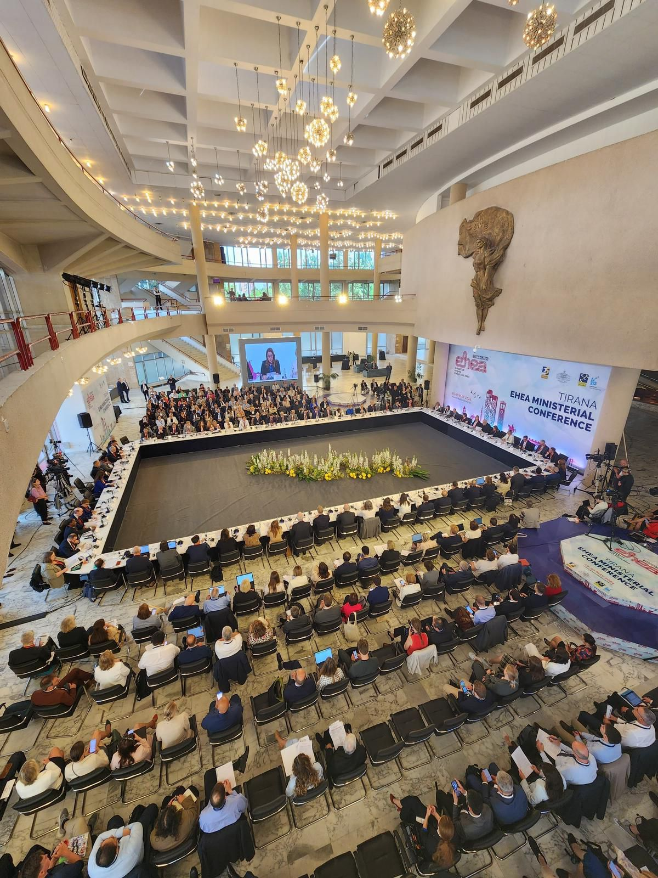

Slide 3
Tirana Ministerial Communiqué 2024
As in Paris in 2018, we today reaffirm our three key commitments to be preconditions for the successful development and innovation of the EHEA, that is to:
● implement a three-cycle system of programmes and degrees, based on learning outcomes and the European Credit Transfer and Accumulation System (ECTS), compatible with the overarching qualifications
framework of the EHEA (QF-EHEA);
● support the recognition of qualifications throughout the EHEA by implementing the Convention on the
Recognition of Qualifications concerning Higher Education in the European Region (Lisbon Recognition
Convention) and its principles, while working towards automatic recognition in the EHEA; and
● promote a quality culture in higher education, fostered by fit-for-purpose quality assurance processes in line with the Standards and Guidelines for Quality Assurance in the European Higher Education Area (ESG).

Slide 4
Tirana Ministerial Communiqué 2024
The 2024 Bologna Process Implementation Report confirms and illustrates the still incomplete and uneven implementation of these key commitments, but also the important contribution of the Thematic Peer Groups under the guidance of the Bologna Implementation Coordination Group in improving the situation.
Therefore, we commit to ensuring that we have, or will devise, and will publish appropriate action plans to address any remaining implementation gaps, and to promoting knowledge-sharing activities related to the EHEA.
As the Bologna Process tools have developed throughout the last decade, we mandate the BFUG to work on their future-proof development, dissemination and possible expansion.

Slide 5
Tirana Ministerial Communiqué 2024
We invite the authors of the ESG to propose a revised version by 2026 to the BFUG, to be adopted by us at our 2027 Ministerial conference, as well as an adjustment, where required, of the European Approach for Quality Assurance of Joint Programmes.
We will also promote more robust and transparent quality assurance of transnational education delivered worldwide, in line with the ESG, to protect the interests of students.
Furthermore, we are committed to countering diploma and accreditation mills, fraudulent qualifications and academic cheating services, made more accessible through developments in the digital field.
Notes:
The primary authors are ENQA, ESU, EUA and EURASHE - the E4 Group, in cooperation with Business Europe, EI and EQAR.

Slide 6
Tirana Ministerial Communiqué 2024
We reaffirm our commitment to making automatic recognition of qualifications and learning periods abroad a reality for all students and graduates, welcome the revision of the European Area of Recognition (EAR) Manual and the use of other tools developed by the ENIC-NARIC networks, and will continue to promote the use of quality assurance and transparency tools, such as DEQAR.
We commit to supporting transnational cooperation, including for joint programmes and joint degrees, through better implementation of the key commitments and by removing undue administrative and legal barriers.

Slide 7
E
H
E
A
S
E
C
R
E
T
A
R
I
A
T
BFUG
BFUG Board
WG on Monitoring Implementation
WG on Internationalisation & Mobility
Bologna Implementation CG
AG ECTS
TPG A – Qualifications' Frameworks
TPG B - Recognition
TPG C – Quality Assurance
TPG D – Social Dimension
WG on Fundamental Values
TF on the Future of Bologna
CG Global Policy Dialogue
Drafting committee
TF Long term secretariat
Notes:
In the 2021-2024 cycle, the BFUG had in total 13 working structures, excluding the Drafting Committee. This implies 2.5 working structures more than the average for the last 6 cycles of the EHEA, which is 11.5 working structures.
The cycle with the most working structures has been the 2007-2009 cycle, with 15 working structures.
The proposal for the Work Programme 2024-2027 includes 11 working structures, excluding the Drafting Committee and the two dedicated processes of revising the ECTS Users’ Guide and the ESG.

Slide 8
Working Group on Monitoring and Implementation
2027 BPIR Monitoring report
A decision regarding the monitoring approach-comprehensive and/or thematic - should be made based on the discussion initiated in the previous semester
Tirana Communiqué
“We mandate the BFUG to ensure that policy commitments aiming at creating by 2030 an inclusive, innovative, and interconnected EHEA, mindful of the fundamental values, are properly monitored, including through a Bologna Process Implementation Report that assesses key developments.” and “We commit to measuring progress in the implementation of the Principles and Guidelines to Strengthen the Social Dimension of Higher Education in the EHEA and ask the BFUG to report back on this in 2027.”
Co-chairs:
Austria
Eurydice
Malta
Notes:
Rome: https://ehea.info/Upload/Rome_Ministerial_Communique_Annex_II.pdf
https://ehea.info/Immagini/BFUG-WG-on-SD-Indicators-and-Descriptors-Final.pdf
https://ehea.info/Immagini/ANNEX-1-EHEA-STATEMENTS-ON-FUNDAMENTAL-VALUES.pdf

Slide 9
Working Group on Fundamental Values
Tirana Communiqué
“Higher education can only fully develop its missions when its fundamental values are respected. While they are now more threatened than they were a decade or even four years ago, we reaffirm our commitment to protect, promote, and uphold academic freedom, as defined in the Rome Communique. In addition, we commit to upholding, promoting, and protecting the following values: ( . . .) academic integrity, institutional autonomy, participation of students and staff in higher education governance, public responsibility for higher education, public responsibility of higher education (. . . )“
Notes:
Academic freedom, as defined in the Rome Communique https://ehea.info/Upload/Rome_Ministerial_Communique_Annex_I.pdf
Tirana: academic integrity, institutional autonomy, Participation of students and staff in higher education governance, Public responsibility for higher education, Public responsibility of higher education https://ehea.info/Immagini/ANNEX-1-EHEA-STATEMENTS-ON-FUNDAMENTAL-VALUES.pdf
https://ehea.info/Immagini/WG-on-FV-Final-Version1.pdf - Monitoring framework

Slide 10
Working Group on Fundamental Values
monitoring framework
first comprehensive evaluation
raising awareness, dissemination and support activities
Tirana Communiqué
“We welcome the work on creating a technical monitoring framework, and we ask the BFUG to report back to us at our 2027 Ministerial Conference.”
Co-chairs:
Romania
Malta

Slide 11
Working Group on Internationalisation and Mobility
action plan
links with all working structures, which should have as one of the aims to outline how their work can foster mobility
Tirana Communiqué
“We mandate the BFUG to prepare an action plan to stimulate mobility and internationalisation of higher education and to support measures for achieving a greener, more inclusive, and more balanced mobility”, “We will support higher education institutions in their exploration of practices and benefits of blended mobility and virtual exchanges, and in fostering the internationalisation of the curricula. We commit to supporting transnational cooperation, including for joint programmes and joint degrees, through better implementation of the key commitments and by removing undue administrative and legal barriers” and “We reaffirm our commitment to enabling all learners to acquire international and intercultural competencies, and we will reinforce our efforts to identify and remove barriers and promote physical mobility, also in order to achieve the benchmark of at least 20% of mobile students”.
Co-chairs:
Germany Moldova Netherlands Ukraine
Notes:
A WG on Mobility was included in the 2007 2012 Action Plan, which developed an Action plan on mobility in 2012. https://ehea.info/media.ehea.info/file/2012_Bucharest/39/2/2012_EHEA_Mobility_Strategy_606392.pdf
2009 Leuven and Louvain-la-Neuve: In 2020, at least 20% of those graduating in the European Higher Education Area should have had a study or training period abroad.

Slide 12
Task Force on Future of Bologna
prepare and organise debates in the BFUG
more content discussions within the BFUG
future-proof development, dissemination and possible expansion of key commitments
links with the BICG and other working structures
outreach towards stakeholders
Tirana Communiqué
“We also ask the BFUG to submit to us in 2027 proposals for the priorities main for the next decade, in close cooperation with higher education institutions, staff and students.”
Co-chairs:
Belgium Flemish Community, Germany, Ireland, Ukraine

Slide 13
Coordination Group on Global Policy Dialogue
Tirana Global Policy Forum Statement
“We invite all participants in the EHEA Global Policy Forum to continue to engage in global policy dialogue and to identify the themes where synergies can be found between regions, and with global organizations such as UNESCO and OECD, be it at the intergovernmental level, or in transnational exchange and collaboration between higher education institutions and organisations.”
Notes:
https://ehea.info/Immagini/Global-Policy-Forum-Statement.pdf

Slide 14
Coordination Group on Global Policy Dialogue
prepare the statement for the Iași & Chișinău Bologna Policy Forum
engagement with other parts of the world
coordination with regional or interregional organisations dealing with HE policies
synergies in different policy area
Tirana Communiqué
“We ask the BFUG and its working structures to continue to develop and strengthen dialogue and collaboration with macro regions on various levels and with appropriate interlocutors.” and “This includes reciprocal referencing of qualifications frameworks and credit systems, ratification and implementation of the UNESCO Global Convention on the Recognition of Qualifications concerning Higher Education, as well as the second generation regional recognition conventions, and alignment and mutual understanding of quality assurance principles.”
Co-chairs:
Italy
Moldova UNESCO

Slide 15
Bologna Implementation Coordination Group and the Thematic Peer Groups
Bologna Implementation CG
Tirana Communiqué
“As in Paris in 2018, we today reaffirm our three key commitments to be preconditions for the successful development and innovation of the EHEA…” , “the important contribution of the Thematic Peer Groups under the guidance of the Bologna Implementation Coordination Group in improving the situation. Therefore, we commit to ensuring that we have, or will devise, and will publish appropriate action plans to address any remaining implementation gaps (…).” and “We, together with stakeholders and communities, commit to tackling the socio-economic challenges, such as the rising cost of living and difficulty to access student housing, that have impacted access to higher education and student life as a whole. We will intensify our efforts to ensure the recognition of qualifications held by refugees and to remove barriers to their enrolment in higher education.”
TPG A – Qualifications' Frameworks
TPG B - Recognition
TPG C – Quality Assurance
TPG D – Social Dimension

Slide 16
Bologna Implementation Coordination Group and the Thematic Peer Groups
Continuation of the thematic peer approach
TPG D: promoting the Principles and Guidelines on Strengthening the Social Dimension of EHEA, also covering aspects related to student-centred learning
BICG Co-chairs:
Bulgaria, Finland, EUA
Co-chairs:
TPG A – France, Georgia, Latvia,
TPG B - France, Italy, Ukraine
TPG C – Armenia, France, Romania
TPG D – ESU, Latvia, Malta

Slide 17
Task Force on Long-term Secretariat
Terms of reference
Tirana Communiqué
“We mandate the BFUG to continue working on the possibility of establishing a long-term, independent, internationally staffed Secretariat to create effective support for the BFUG, and to evaluate the feasibility and sustainability of the related proposals, models, and terms of reference in Spring 2026, to be presented for adoption and implementation at our 2027 Ministerial Conference.”
Co-chairs:
Czech Republic
EUA

Slide 18
Drafting Committee
Starts its work during the first semester of the year preceding the Ministerial Conference and the Global Policy Forum - 2026.
Composed of the Co-Chairs of the three semesters before the Ministerial Conference (Cyprus, Norway, Ireland, Montenegro, Lithuania, North Macedonia), the Vice Chair (Romania), and one consultative member who is proposed by the consultative members and subject to the approval of the BFUG.
The BFUG may appoint the chair(s) or leave it to the Drafting Committee to decide on the chairing arrangements at its first meeting.
The Drafting Committee submits a roadmap for its work to the BFUG for approval.

Slide 19
Advisory Group on ECTS Revision
Revised ECTS Guide
Tirana Communiqué
“To support the implementation of
the ECTS, including learning outcomes, we invite the BFUG to review the ECTS Users’ Guide 2015 by 2027, to strengthen its key features and adapt it to current developments, including micro credentials.”
Co-chair:
EC
Notes:
https://ehea.info/media.ehea.info/file/2015_Yerevan/72/5/ECTS_Users_Guide_2015_613725.pdf

Slide 20
Timeline
Filling in the call for interest
for membership in working
structures
01.
02.
Preparing draft ToRs
21 October 2024
1st November 2024
Meeting with the co-chairs of
the working structures
03.
04.
Sending the draft ToRs to the BFUG
5 November 2024
November 2024
Online procedure approval
05.
06.
Start working
22 November 2024
December 2024

Slide 21
Thank you!
EHEA: Transforming Education Together
https://ehea.info
secretariat@ehea.info

