Slide 1
EQAR’s contribution to the new working cycle of the BFUG
Members’ Dialogue
29 October 2024

Slide 2
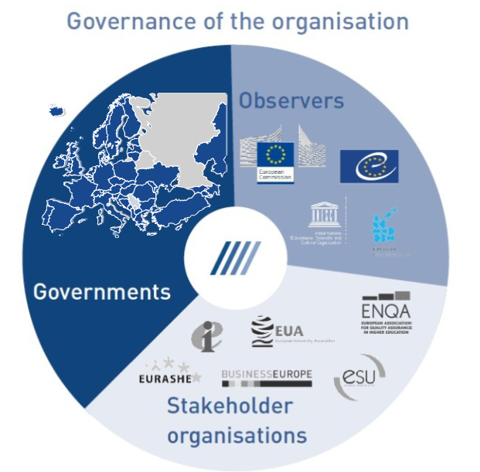
EQAR: Mission and Role
Increase the transparency of quality assurance,
Provide clear and reliable information on quality assurance provision in Europe
Thus:
Enhancing trust among actors
Strengthening confidence in European higher education
Promoting mobility and recognition
To achieve this, EQAR:
Manages a register of QA agencies that substantially comply with the ESG
Provides publicly accessible dana on external QA results (DEQAR)

Slide 3
EQAR Mission
Relevant to:
The revision of the ESG
Automatic recognition
Use of the European Approach for QA of Joint Programmes
Cross-border QA
Progress in the QA of microcredentials
Topical and developmental initiatives related to QA and recognition
DEQAR supports our role as a
trusted authority in ensuring quality standards across the EHEA

Slide 4
EQAR’s contribution to the EHEA
EHEA key committments:
A Three-Cycle System compatible with the QF-EHEA
Compliance with the Lisbon Recognition Convention (LRC)
Quality Assurance in compliance with the ESG
Notes:
implementing the European Qualification Framework (EQF)
Implementing ECTS

Slide 5
EQAR’s contribution to the EHEA
EHEA key committments:
A Three-Cycle System compatible with the QF-EHEA
Compliance with the Lisbon Recognition Convention (LRC)
Quality Assurance in compliance with the ESG
Notes:
implementing the European Qualification Framework (EQF)
Implementing ECTS

Slide 6
EQAR’s contribution
EHEA Key commitment 2: Recognition
Facilitate international recognition in EHEA in line with the LRC
Through:
Maintaining a register of trustworthy QA agencies and their external QA results
EQAR knowledge database as a:
Unique repository of experience
In-depth knowledge of the QA landscape
Understanding of the concrete of issues of recognition
DEQAR as a powerful and up-to-date information and transparency tool, with links to:
ENIC-NARICs tools and workflows
European Digital Credentials for learning (EDC) infrastructure
European Blockchain Services Infrastructure (EBSI)
(in future) European Higher Education Sector Observatory (EHESO)

Slide 7
EQAR’s contribution
EHEA Key commitment 3: Quality Assurance
External evaluation of QA agencies: maintaining trust in external QA results in EHEA
Contribution to the revision of the ESG
Contribution to new developments in the field of external QA
Through:
Maintaining a register of trustworthy QA agencies (emphasising consistency and transparency in external evaluation of QA agencies)
1Membership in the ESG revision Steering Committee and constant liaising with the E4 and social partners (Education International and Business Europe)
Revision of the European Approach to QA of Joint Programmes
Providing expert input or support on different developmental initiatives:
QA of micro-credentials and other providers (including information on their certification)
European degree

Slide 8
EQAR’s contribution
Applications for membership in BFUG working structures:
Working Group on Monitoring (Implementation)
Thematic Peer Group B on Recognition
Thematic Peer Group C on Quality Assurance
Task Force on a Long-term Secretariat

Slide 9
Thank you!

