Slide 1
EQAR’s contribution to the European degree initiative
EQAR Members’ Dialogue
28 October 2024

Slide 2
European policy documents
Blueprint for a European degree (Communication of the European Commission
Proposal for a Council Recommendation on a European quality assurance and recognition system in higher education (with annexes)

Slide 3


European degree (label)

Slide 4
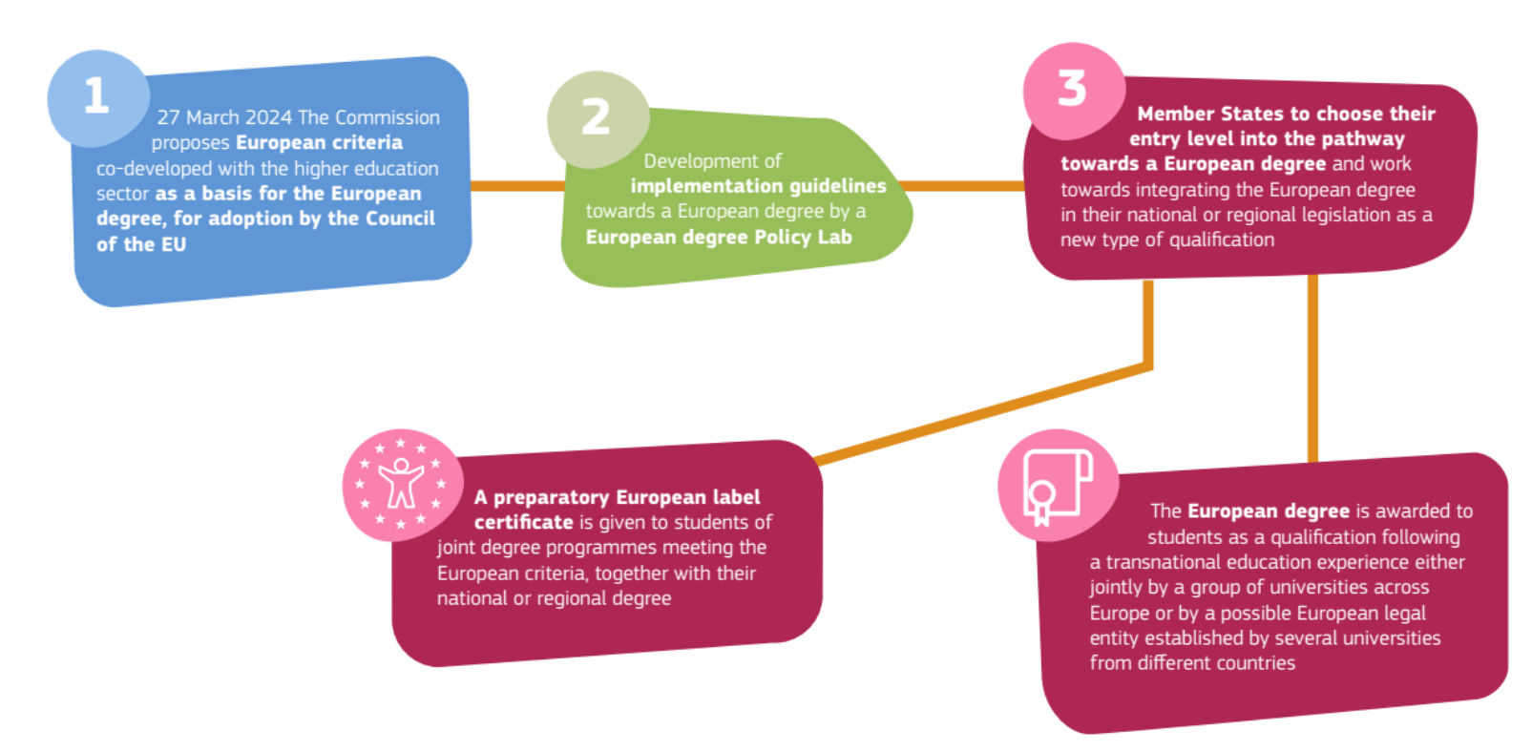
European degree (label)

Slide 5






European degree (label)
European degree (label) criteria
EQAR-registered QA agency
Joint degree with
the European label
complies with
confirmed by
awards
received by
Programme
Graduate
European degree

Slide 6
Q&A
In which dimension of the European degree initiative do you consider EQAR's participation
important and beneficial?

Slide 7
EQAR’s contribution
Blueprint for a European degree (Communication of the European Commission
Setting up of the European degree policy lab and the European degree forum, in which EQAR will participate
further development of DEQAR to make it more user-friendly and to link it directly with automatic recognition of qualifications;

Slide 8
EQAR’s contribution
Proposal for a Council Recommendation on a European quality assurance and recognition system in higher education (with annexes)
Developing a cross-institutional quality assurance approach for alliances of higher education institutions, to be conducted by an EQAR-registered agency
Recommending the member states to allow the EQAR-registered agencies to award the European label, or to grant to HEIs the ability of awarding the European label, to joint programmes that meet the criteria
Recommending the member states to work with EQAR to identify ways to complement the regular ESG review of the work of national quality assurance agencies in ensuring that joint programmes match the European criteria
Creating a repository of programmes that have met the European criteria and are eligible to award a European degree
Use of EQAR registration in the European degree (label) criteria

Slide 9

European degree (label)
European degree (label) criteria
EQAR-registered QA agency
Joint degree with
the European label
complies with
confirmed by
awards
received by
Programme
Graduate
European degree

Slide 10
European degree (label)
European degree (label) criteria
EQAR-registered QA agency
Joint degree with
the European label
complies with
confirmed by
awards
received by
Programme
Graduate
European degree

Slide 11
European degree (label)
European degree (label) criteria
Process of continuous refinement of the European degree (label) criteria

Slide 12
European degree (label)
European degree (label) criteria
EQAR-registered QA agency
Joint degree with
the European label
complies with
confirmed by
awards
received by
Programme
Graduate
European degree

Slide 13

European degree (label)
EQAR-registered QA agency
Developing new modalities of registration and verifying suitability of the agency to conduct
European degree evaluations

Slide 14
European degree (label)
European degree (label) criteria
EQAR-registered QA agency
Joint degree with
the European label
complies with
confirmed by
awards
received by
Programme
Graduate
European degree

Slide 15



European degree (label)
Serve as a repository of (information on)
European degree (label) awarding programmes
Joint degree with
the European label
awards
Programme
European degree

Slide 16
To which degree can EQAR contribute to the following elements of the initiative:
Refining the European degree (label) criteria
Serving as a repository of (information about) joint programmes that award European degrees
Serving as a repository of (information about) joint programmes that award European degrees
The work of the European degree policy lab (expert group)

Slide 17
Q&A
How important is
the European degree initiative for EQAR?

Slide 18
Final comments or questions?

