Slide 1
Una Europa’s approach to QA of joint programmes
Sophia Karner, Senior Policy Officer, Una Europa vzw

Slide 2
Una Europa University Partners
Freie Universität Berlin
Università di Bologna
University College Dublin
University of Edinburgh
Helsingin Yliopisto
Uniwersytet Jagielloński w Krakowie
Universiteit Leiden
KU Leuven
Universidad Complutense de Madrid
Université Paris 1 Panthéon-Sorbonne
Universität Zürich
UNA Europa presentation
Notes:
Together, we are forging a new path for education and research in Europe and beyond to shape our shared future for the better.
Founded in 2019, Una Europa has secured successive rounds of European Union funding to realise our vision for a European ‘University of the Future’.
Guided by our 2030 Strategy, Una Europa is working towards a truly inter-university and pan-European campus, shaped by universities’ central obligations to society: research and innovation, teaching and learning, and societal outreach.

Slide 3
Advancing European higher education
The education of future European citizens is vital in facing major societal challenges. Universities are uniquely positioned to play a key role in this endeavour.
Una Europa is committed to equipping the leaders and problem-solvers of tomorrow by advancing European higher education for all learners.
Bachelor
PhD
Flexible learning
Joint Bachelor of Arts in European Studies
Joint Bachelor of Arts in Sustainability (forthcoming)
Doctoral Programme in Cultural Heritage
Joint Doctoral Spaces in Cultural Heritage
Lifelong Learning Certificates (Data Science/ Sustainability)
Micro-credential Programme in Sustainability
MOOC: AI in Society
Una Europa’s portfolio of courses and programmes

Slide 4
Case Study: Una Europa Joint Bachelor in European Studies (BAES)

Slide 5
The programme & partner universities
Joint programme on fundamental aspects and values of the EU as well as European states / societies.
International: Stays at 2-3 partner universities
Multidisciplinary: joint multidisciplinary curriculum followed by selection of major and minor out of seven fields of study
Degree-awarding partners:
KU Leuven (Belgium)
Alma Mater Studiorum Università di Bologna (Italy)
Universidad Complutense de Madrid (Spain)
Uniwersytet Jagiellonski w Krakowie (Poland)
Mobility partners:
Freie Universität Berlin (Germany)
Helsingin Yliopisto/Helsingfors universitet (Finland)
The University of Edinburgh (United Kingdom)
Université Paris 1 Panthéon-Sorbonne (France)
Universität Zürich (Switzerland)
Notes:
Seven fields of study:
Law and Criminology
Politics and International Relations
Communication, Education, Gender and Sociology
Business and Economics
Philosophy
History
Languages and Culture

Slide 6
Approach to External QA
Accreditation via European Approach for Quality Assurance of Joint Programmes (2021) via Accreditation Organisation of the Netherlands and Flanders (NVAO)
Main Challenges
Restrictive national legislation as to the implementation of the European approach and mutual recognition, resulting in additional procedures at national level;
Restrictive national legislation regarding the possibility to create an interdisciplinary programme/degree, or degrees in specific fields;
Restrictive national legislation regarding the necessary components of the graduation diploma and the joint diploma and graduation rules;
Restrictive national legislation regarding curriculum aspects (minimum or maximum ECTS credits per course; minimum ECTS credits for truncus communis; determining a maximum number of evaluations for a programme, etc.)
Restrictive legislation regarding selection of students
…
Positive conclusion: As a joint framework, the European Approach is a great tool for going through a joint external quality assessment together with partner universities of countries where the Approach is recognised.

Slide 7
Approach to Internal QA
“Una Europa’s blueprint for internal quality assurance of joint programmes” developed by Una Europa Quality Assurance cluster to support the realisation of single accreditation of joint programmes according to the European Approach.
Trust between partners: Based on the common understanding that each partner institution operates a well-functioning internal quality assurance system, the partners opted to make maximal use of the partners’ existing methods.
Need for a joint framework incorporating existing institutional protocols to a maximum extent to ensure effective decision-making and communication between the partners:
General principles for the internal QA of joint programmes (principles of verified trust, subsidiarity and core practices)
Creation of a knowledge database: transparent information and communication about the functioning of the internal quality assurance system of each partner
Definition of responsibilities regarding quality assurance and enhancement on the level of the management of a joint programme (i.e. Quality Assurance Board)
Transition towards a holistic joint system for internal quality assurance and enhancement: i) extension towards other educational formats and ii) Europa’s vision on teaching & learning.

Slide 8
Una Europa’s interest in the European Degree
Recognition for importance of European Degree topic from the outset
Experience of Joint Bachelor in European Studies
Development of Joint Position on the European Degree (label) in collaboration with Unite! and support of EC2U, CHARM-EU, 4EU+ and EU-CONEXUS in early 2021
Coordination of ED-AFFICHE project (2023–2024), policy experimentation project funded by Erasmus+, with involvement of 51 HEIs across 22 MS
Common vision of the European Degree label as an enabler to remove obstacles and closer collaboration
Need for more supportive framework
Notes:
Highlight legislative and administrative hurdles in the development and implementation of the BAES
Higher Education Package (small step in the right direction) – accompanying staff working document heavily influenced by ED-AFFICHE recommendations
European criteria – ED-AFFICHE around the table throughout the past year in the co-development

Slide 9
ED-AFFICHE project
Overarching objectives:
Design of a European Degree (label) with a view to maximizing its attractiveness and potential impact on European higher education at large
Ensure synergies with Bologna tools and promote more flexibility
Input for Higher Education Package, including ‘Communication on a Blueprint for a European Degree’ (March 2024)
Importance of building on project results, i.e. Deliverable on Obstacles for Transnational Collaboration in Higher Education (Accreditation, Quality Assurance of New Programmes, Flexible Learning Paths, Curricula, and Governance Structures)
Conclusion: clear concept is key and implementation requires co-creation with all stakeholders around the table, i.e. European Degree Policy Lab, avoiding parallel processes must be a priority.
Una Europa approach for lean and efficient systems that build on existing tools and frameworks.
Notes:
Highlight legislative and administrative hurdles in the development and implementation of the BAES
Higher Education Package (small step in the right direction) – accompanying staff working document heavily influenced by ED-AFFICHE recommendations
European criteria – ED-AFFICHE around the table throughout the past year in the co-development

Slide 10
Stay in touch with Una Europa

Slide 11
The Una Europa vzw team
Get in contact: info@una-europa.eu
Emily Palmer Secretary-General
Melissa Claessens Internal Partnerships Officer
Zoë De Paepe Operations Officer
Sophia Karner Senior Policy Officer
Dee Kilbride Communications Manager
Heather McComb
Digital Communications Manager
Nick Ollivère
Senior External Funding Officer
Andrew Whitehead Senior Governance Officer

Slide 12
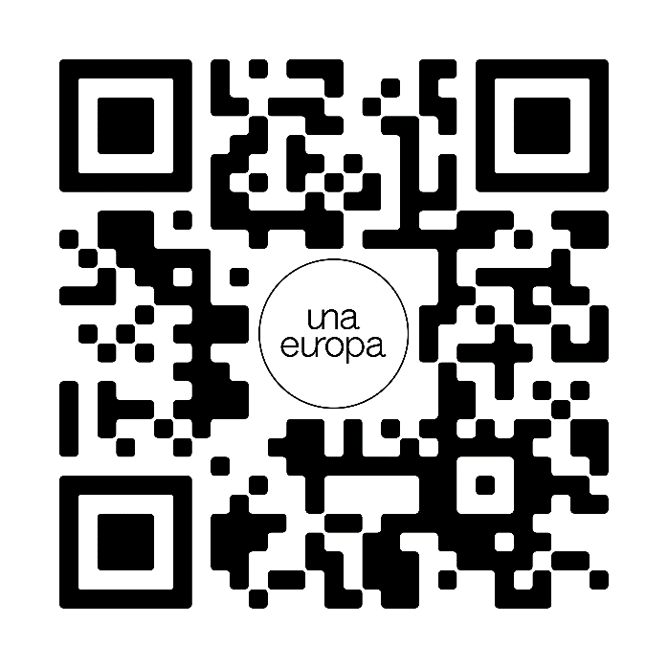
@Una_Europa #WeAreUnaEuropa
Follow Una Europa on social media or subscribe to our monthly newsletter:

