Slide 1

Quality of Recognition
Insights from the analysis of reports by EQAR registered agencies
2024 Members’ Dialogue
28-29 October 2024
Maria Manatos

Slide 2
Content
Background
Research questions
Methodological approach
Results
Considerations/recommendations

Slide 3
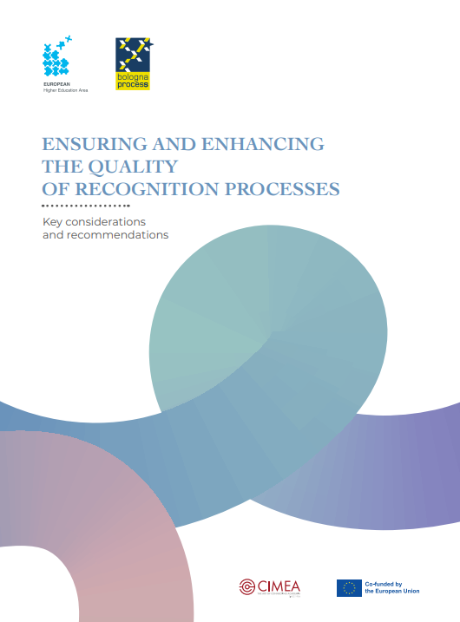
Background
Developed within the TPG-LRC Constructing Recognition in the EHEA (TPG-LRC CoRE) project
Project aims to support the implementation of the Bologna Process focusing on its key commitment 2 on national legislation and procedures compliant with the Lisbon Recognition Convention (LRC) in the countries of TPG B
Key considerations and recommendations on how to better implement LRC, as well as how to better link recognition and quality assurance (QA)

Slide 4
Background
Principles of LRC
ESG
ESG 1.4
Recognition
Quality Assurance

Slide 5
Background
ESG 1.4 Student admission, progression, recognition and certification
Standard: Institutions should consistently apply pre-defined and published regulations covering all phases of the student “life cycle”, e.g. student admission, progression, recognition and certification.
Guidelines: Providing conditions and support that are necessary for students to make progress in their academic career is in the best interest of the individual students, programmes, institutions and systems. It is vital to have fit-for-purpose admission, recognition and completion procedures, particularly when students are mobile within and across higher education systems.
It is important that access policies, admission processes and criteria are implemented consistently and in a transparent manner. Induction to the institution and the programme is provided.
Institutions need to put in place both processes and tools to collect, monitor and act on information on student progression.
Fair recognition of higher education qualifications, periods of study and prior learning, including the recognition of non-formal and informal learning, are essential components for ensuring the students’ progress in their studies, while promoting mobility.
Appropriate recognition procedures rely on
- institutional practice for recognition being in line with the principles of the Lisbon Recognition Convention;
- cooperation with other institutions, quality assurance agencies and the national ENIC/NARIC centre with a view to ensuring coherent recognition across the country.
Graduation represents the culmination of the students’ period of study. Students need to receive documentation explaining the qualification gained, including achieved learning outcomes and the context, level, content and status of the studies that were pursued and successfully completed.

Slide 6
Research Questions
How both the standard and the more detailed guidelines of ESG 1.4 regarding recognition are evaluated by EQAR registered agencies?
  1.1. Are the elements of the ESG 1.4 (on student admission, progression, recognition and certification) explicitly covered in review reports of EQAR registered agencies?
  It includes all phases of the student life cycle in order to identify the relative weight given to recognition in external QA.

Slide 7
Research Questions
1.2 How frequent is the topic of recognition in the external evaluation of the HEIs? What are the observations of EQAR registered QA agencies regarding the quality of recognition procedures of HEIs in the EHEA?
Whether institutions have:
fair procedures
implemented in a consistent and transparent manner
in line with the principles of the LRC
made in cooperation with other institutions, QA agencies and the national ENIC-NARIC centres with a view to ensuring coherent recognition across the country.
Takes into consideration the periods of study and prior learning, including the recognition of nonformal and informal learning.

Slide 8
Methodological approach
Database for External Quality Assurance Results (DEQAR)
Institutional reviews uploaded by EQAR registered agencies
EQAR registered QA agencies’ websites and their documentation (methodologies used by EQAR registered agencies)
Coherence and consistency in the sample

Slide 9
Methodological approach
Inclusion criteria | Exclusion criteria
Reports written in English language | Follow-up reports
Reports published after 2015 (i.e. the year of the publication of the revised ESG) | Institutional responses and appeals
Reports of HEIs based in the EHEA | Reports assessing study programmes, despite being classified as institutional assessment reports
Reports resulting from institutional reviews only | Reports assessing faculties or departments.
1 report per institution | Older reports (in case of several reports of 1 institution)
Current QA methodologies

Slide 10
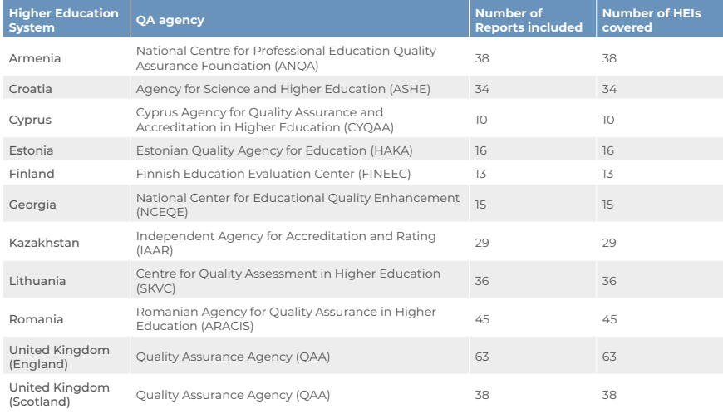
Research sample
337 reports | 11 EHEA countries

Slide 11
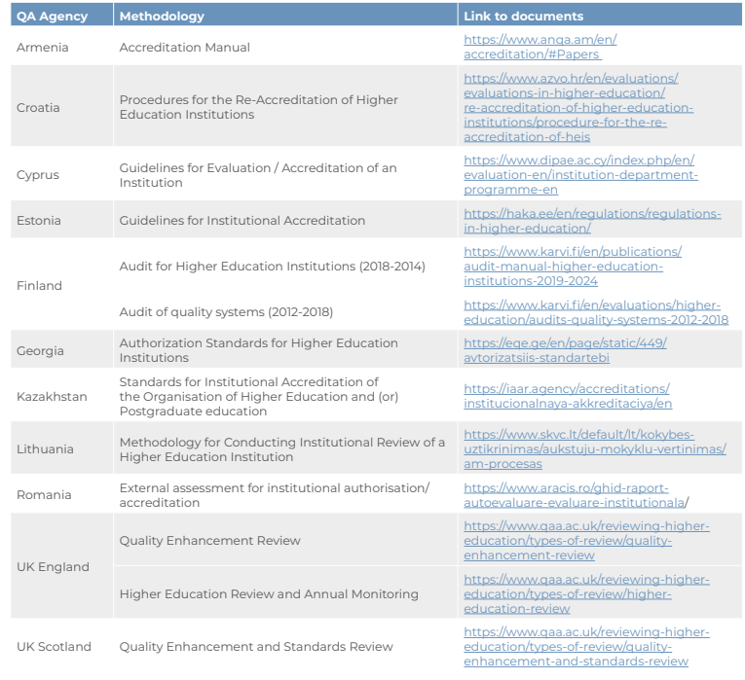
Research sample: QA Agencies’ methodologies

Slide 12
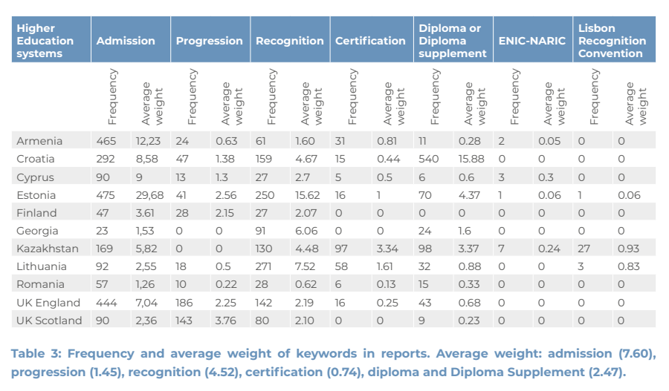
Results
Are the elements of ESG 1.4 (admission, progression, recognition and certification) explicitly covered in review reports?

Slide 13
Results
Are the elements of ESG 1.4 (admission, progression, recognition and certification) explicitly covered in review reports?
The 4 elements are present in the majority of the reports, though at very different frequency.
Focus more on the phases of admission and recognition, followed by certification (including diploma and the diploma supplement) and in the end, progression.
Focusing on the recognition aspects, in most of the reports, the concept appears twice on average.

Slide 14
Results
What are the observations regarding the quality of recognition procedures of HEIs?
The evaluations of HEIs cover similar aspects.
Absence of specific references to LRC but principles are present.
Consistency, transparency , fairness flexibility and of recognition procedures
Link between quality of recognition and efforts to attract more international students
The procedures of HEIs cover not only the recognition of qualifications gained through academic programmes, but also skills and competencies gained through other means/ methods of learning:
  turn job competencies into academic ones
  the implementation of recognition of non-formal and informal learning
Recommendations focus on policies for targeting recognition of prior learning gained through academic mobility and non-formal and informal pathways.

Slide 15
Results: further improvement
The efficacy of the recognition process
Transparency of procedures related to prior studies and credit transfer
Familiarity with the procedures by the applicants
Cooperation between HEIs, QA agenies and the ENIC-NARICs
Regular joint activities and institutional agreements
Fitness for purpose of the recognition processes - evaluate how adequate the recognition processes of the HEIs are and whether they achieve the set aims and objectives

Slide 16
Considerations/ Recommendations
Academic recognition in the EHEA is generally conducted with a high degree of compliance with the main principles of the LRC.
Better awareness and use of special procedures for applicants
Closer link between recognition and QA
Stronger cooperation between ENIC-NARIC centers, QA Agencies, HEIs
Better evaluation the ‘fit for purpose’ of recognition procedures

Slide 17
QUESTIONS?
THANK YOU!

