Slide 1
The European Approach and a European Degree
D

Slide 2
The road for creating a joint degree programme is extremely complex as every partner must fulfill different and often incompatible national requirements
The situation today:
Accreditation requirements, restrictions on language use
Possibility to have traineeships embedded in curricula
Admission policies, mobility rules
Requirements for diploma templates
Differences in use of ECTS

Slide 3
Use of the European Approach (EQAR data)

Slide 4
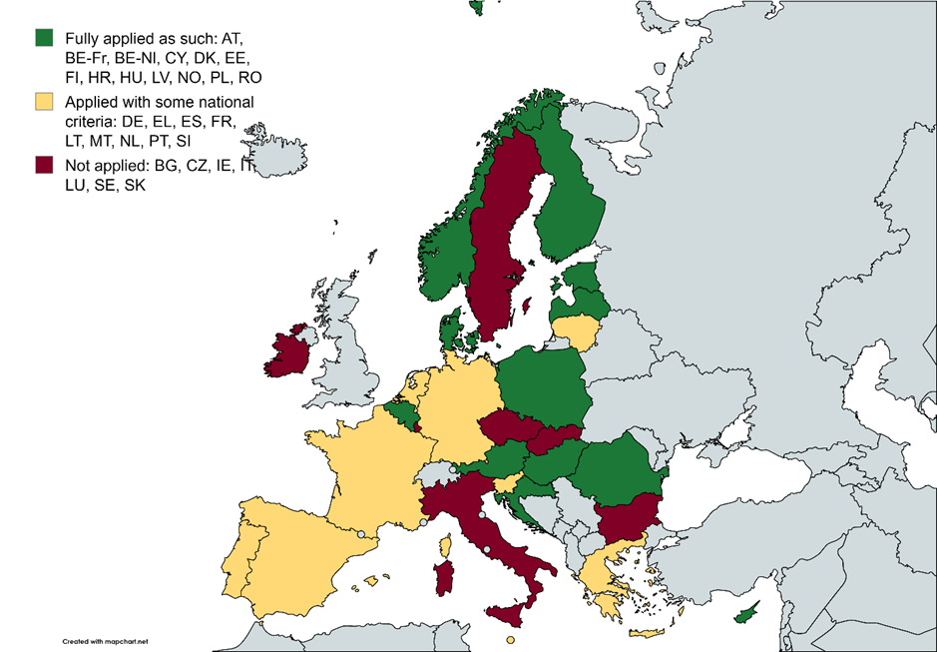
Application of the European Approach

Slide 5
Council recommendation on European quality assurance & recognition system in higher education

Slide 6
Recommendations: 2nd pillar System-specific recommendations for more agile transnational cooperation
Once only
principle
Developing a cross-institutional quality assurance approach
for alliances of higher education institutions for their joint activities
Make programme/combined approaches to external quality assurance more agile by:
Allow and encourage the use of the European Approach by:
Encouraging a robust internal quality assurance process
Removing any unjustified barrier to its use
Moving towards institutional approach for quality assurance
Creating an enabling environment
Strengthening an evidence-based approach to quality assurance
Ensuring no financial disadvantage to its use in comparison to procedures carried out at national level
Supporting peer learning

Slide 7
Recommendations: 3rd pillar Laying the foundations towards a European degree
Allow
- QA agencies registered in EQAR
- HEIs
- alliances of HEIs
the ability to award the European label, in full respect of existing national quality assurance procedures
NO additional procedure.
Adopt the European criteria of the European degree (label)
Annex II Reflect results of the E+ pilots
Work with relevant stakeholders to develop methods to review the criteria with no additional burden for agencies’ evaluation and create a repository of programmes that have met the European criteria
NO additional reviews

Slide 8
Building blocks for a cross-institutional Quality Assurance Framework for alliances of Higher Education Institutions
Builds on the outcomes of the Erasmus+ funded projects QA-FIT and IMINQA;
The evaluation should fully incorporate the ESG.
The Alliance's internal quality assurance ensures that the joint education programmes :
(a) comply with the standards of the European Approach;
(b) meet the European (degree/label) criteria.
The evaluation should be carried out by one EQAR-registered agency, chosen by the Alliance.
The methodology should ensure that each procedure is tailored to the individual Alliance, considering the Alliance's mission, composition (for example, size and geographic spread), and the scope of jointly managed activities.

Slide 9
Thank you
© European Union 2023
Unless otherwise noted the reuse of this presentation is authorised under the CC BY 4.0 license. For any use or reproduction of elements that are not owned by the EU, permission may need to be sought directly from the respective right holders.
Slide xx: element concerned, source: e.g. Fotolia.com; Slide xx: element concerned, source: e.g. iStock.com
Notes:
Update/add/delete parts of the copy right notice where appropriate.
More information: https://myintracomm.ec.europa.eu/corp/intellectual-property/Documents/2019_Reuse-guidelines%28CC-BY%29.pdf

