Slide 1
European Digital Credentials for Learning and DEQAR
The use of accreditation in European Digital Credentials
for Learning
28 October 2024

Slide 2
POLICY CONTEXT
European Pillar of Social Rights
Europass Decision
Achieving the European Education Area (2025)
Individual LearningAccounts Recommendation
European Qualifications
Framework
European Skills, Competences, and Occupations (ESCO)
Micro-Credentials Recommendation
European Digital Credentials for Learning
Digital Education Action Plan 2021-2027
European Skills
Agenda
European Degree
e-IDAS Regulation
Skills & Talent Mobility
European Strategy for Data
EU Cybersecurity Skills Academy

Slide 3
WHY DO WE NEED DIGITAL CREDENTIALS?
Digitalising World
Showcasing Knowledge & Skills
Ownership of Data
Security & Trust
Recognition
Notes:
Why do we need Digital credentials?
Increasingly digitalizing world: Adaptability: As the world transitions to a more digital landscape, it's crucial to replace traditional paper credentials with more agile, easily shareable digital versions - European Commission Vision: Aligning with the EC's digital strategy, fostering a connected and tech-forward European society
Security / Trust - Tamper-proof eSeals: Ensures the authenticity and integrity of each digital credential, making unauthorized changes evident - Combatting Diploma Mills: Digital verifications can decrease the prevalence of fraudulent academic institutions and fake degrees
Recognition (a single way of presenting knowledge and knowing where the credential comes from): Standardised Presentation: Offers a unified way of showcasing achievements, skills, and knowledgeTransparent Origins: Ensures stakeholders know the source and authenticity of every credential, fostering trust
Showcasing your knowledge /skills – adapting to the needs of the labour market : Labour Market Relevance: Highlighting the most sought-after skills and competencies makes candidates more appealing to potential employers - Life-long learning: Digital credentials can inspire lifelong learning, ensuring individuals stay updated and relevant
Ownership of data – the Learner is in control (wallets/ eportfolio etc): Learner Empowerment: Provides learners the control over their achievements, ensuring data privacy and security Digital Wallets & ePortfolios: Facilitates easy management, sharing, and verification of credentials, making it simpler for learners to navigate academic and professional landscapes
Each of these topics will be addressed separately to showcase their value.

Slide 4
WHAT IS OFFERED BY THE INFRASTRUCTURE?
Start with web-based free tools
Adopt custom-built implementation with open-source code
BUILD
ISSUE
STORE
SHARE
VERIFY
credential templates in the Online Builder
Seal and award credentials to owners
credentials securely in one wallet
credential information with one click
credential's authenticity and validity
Notes:
What can we do with the EDCs? What is offered by the infrastructure?
Mention web-based free tool - OCB
Build Compliant credential templates directly in the Online Credential Builder
Issue Credentials and send them to their Owners - Seal and award them to their recipients
Store Credentials securely in a single online or offline wallet
Verify If the credentials are authentic and valid
Share The information in the credential with any other person or organsation with just one click
By using open-source code, you will move toward your own custom-built implementation

Slide 5
HIGHLIGHTS OF CURRENT IMPLEMENTATIONS
European Consortium of Innovative Universities
Using EDCs to issue micro-credentials from the ECIU university alliance
University of Malta
Issuing diplomas as EDCs
National implemention of EDC - Certidigital
Live national level implementation of EDC are upcoming
35.000 credentials in Europass
Currently over 30.000 credentials are being stored in Europass wallets

Slide 6
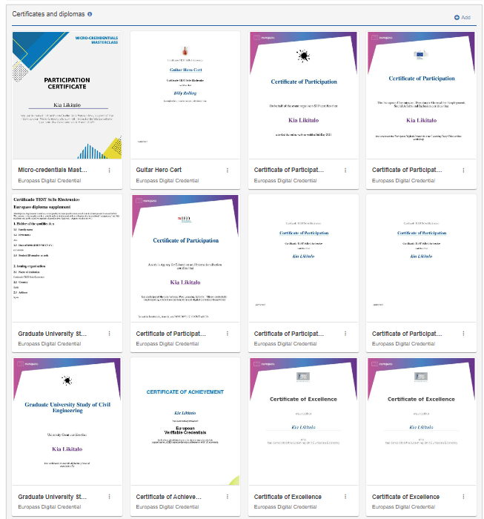
DIGITAL TRANSITION FOR CREDENTIALS
A move beyond paper
Security and Trust
Sharing credentials online
All your credentials in one place
Cost & Time efficiency
Notes:
A move beyond paper: Adapting to the digital landscape
Adapting to market needs : Digital versions of credentials are everywhere
Sharing credentials online : Showcasing your skills in a verifiable way
All your credentials in one place: Create your ePortfolio
Cost & Time efficiency : Streamline credential issuing expenditure

Slide 7
ACCREDITATION CHECK - SUPPORTING RECOGNITION
Verify the origin
Electronic Seals provide trust in origin
Accreditation records
Instantly verify whether an institution is accredited to award a certain qualification
Multilingual by default
Provide and navigate content in 29 different languages
Interoperability
Aligned with existing frameworks (EQF/NQF, ISCED-F, ESCO, micro-credentials Recommendation, etc)
Structured data
A single way of providing data. Improve the understanding of information and interoperability through the use of a single datamodel for learning related information (European Learning Model)

Slide 8
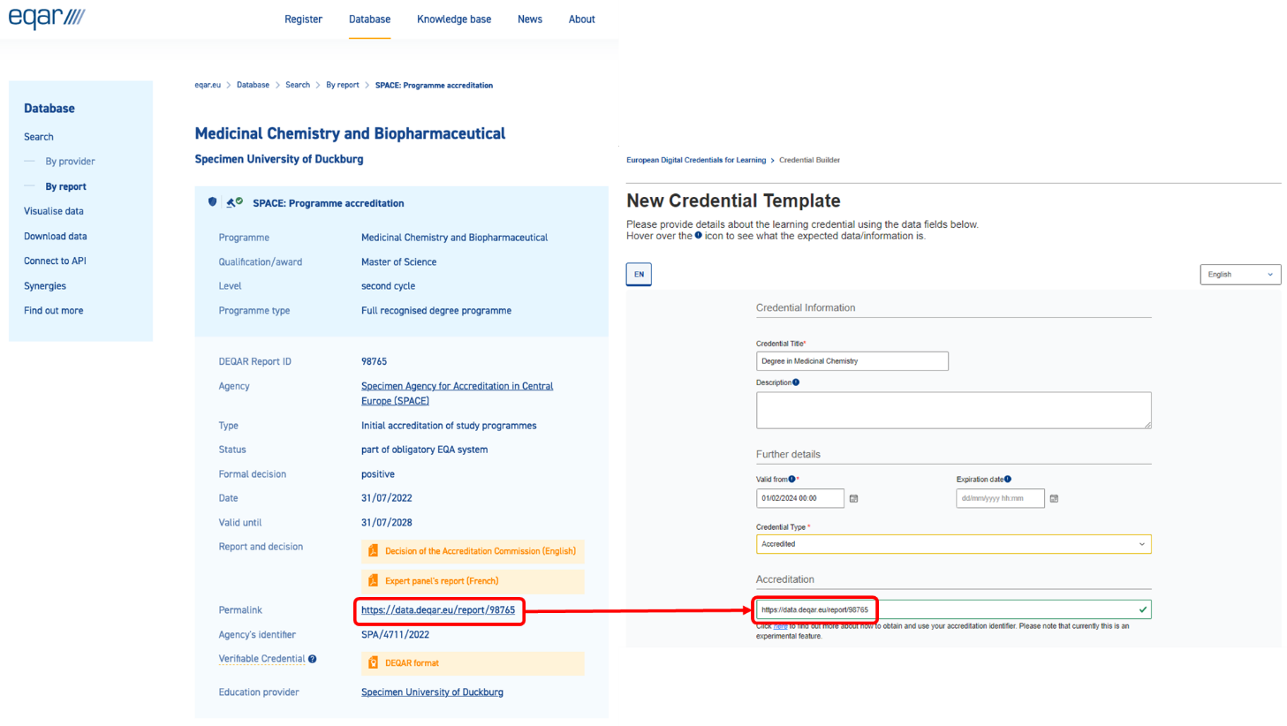
Use of DEQAR in EDC
Direct reference via permalink
Connection to the Accreditation database
Checked against credential content

Slide 9
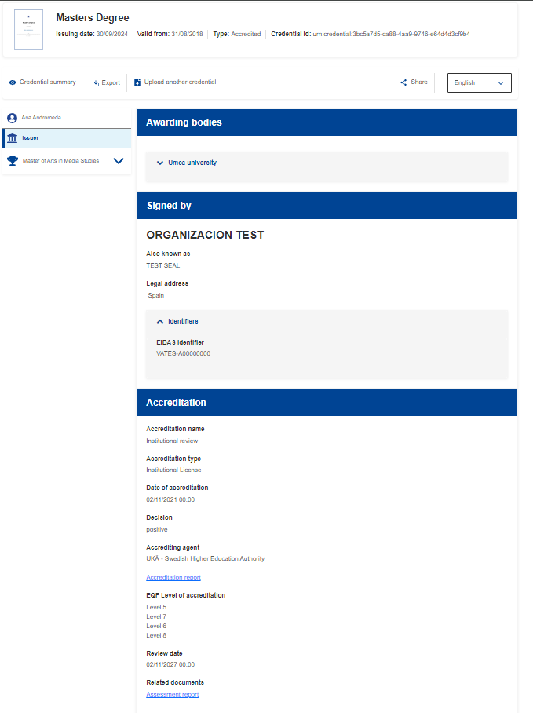
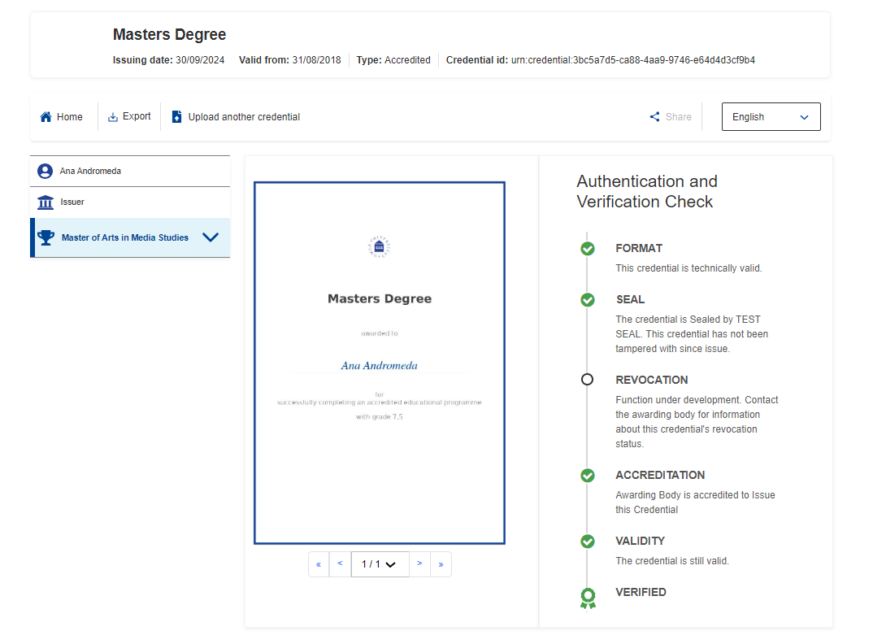
Use of DEQAR in EDC

Slide 10
Still have questions?
Get in touch at:
EMPL-ELM-SUPPORT@ec.europa.eu
and join our Futurium Group!
Notes:
GIVE THE FLOOR BACK TO KOEN

