Slide 1
The Impact of Pandemic in Cross-Border External Quality Assurance in Europe
Nathan Ono de Carvalho;
Maria J. Rosa
and Alberto Amaral
CIPES, University of Aveiro;
DEGEIT and CIPES, University of Aveiro;
CIPES

Slide 2
Background and Purpose
Failure of national quality assurance (QA) systems in providing higher education institutions (HEIs) international recognition
Cross-border Higher Education (CBHE)
CBEQA can be understood as the external QA activities conducted in a country that is not the one where the QA agency is based (ENQA et al, 2017).
(Hou, Morse & Wang, 2017; Trifiro, 2018; Amaral et al, 2016; Hou, 2014; Stella & Woodhouse, 2010)

Slide 3
Background and Purpose
However, in 2020, the COVID-19 pandemic brought significant impacts on the normal functionality of society, including HEIs, QA agencies and governmental bodies (Sahu, 2020; Hou et al, 2021). This work aims to analyse the impact of the pandemic on CBEQA in Europe, using data available in the DEQAR database.

Slide 4
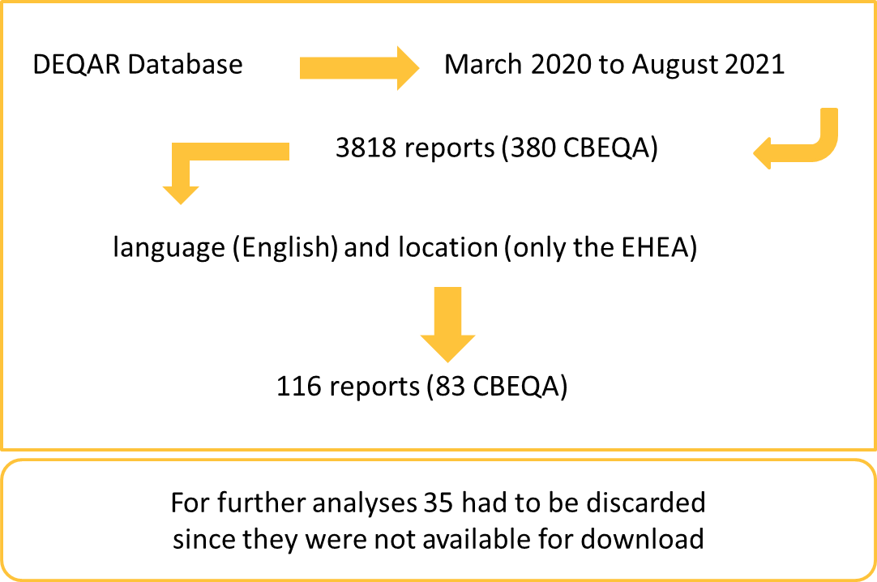
Design methodology
Firstly, data was statistically analysed following a descriptive quantitative approach (Coutinho, 2016); then, an exploratory content analysis of a sample of reports was conducted.
A set of keywords (Covid; pandemic; quarantine; Coronavirus; virus; SARS-COV; crisis; "social distancing"; isolation; lockdown; "distance learning"; "virtual learning"; "remote learning"; "online learning”) was used to perform a search throughout all the filtered reports and select the ones to be content analysed (18).

Slide 5
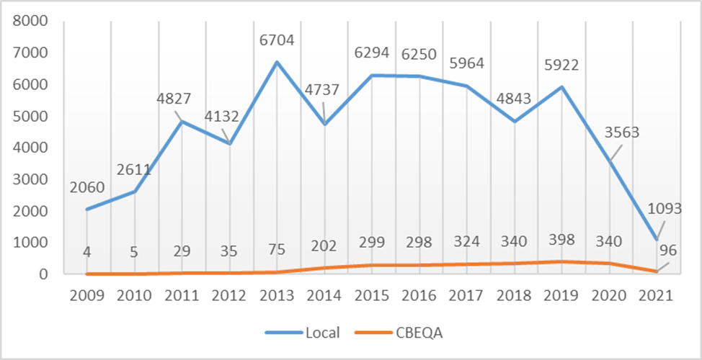
Results and preliminary conclusions
It was possible to identify a decrease both in the total number of reports and CBEQA reports in 2020. Also, the decrease of national activities appears to be cyclic with evidence of three previous falls before 2020. However, the decrease in CBEQA reports was smaller and only occurred in 2020 interrupting a tendency of increase over the years.

Slide 6
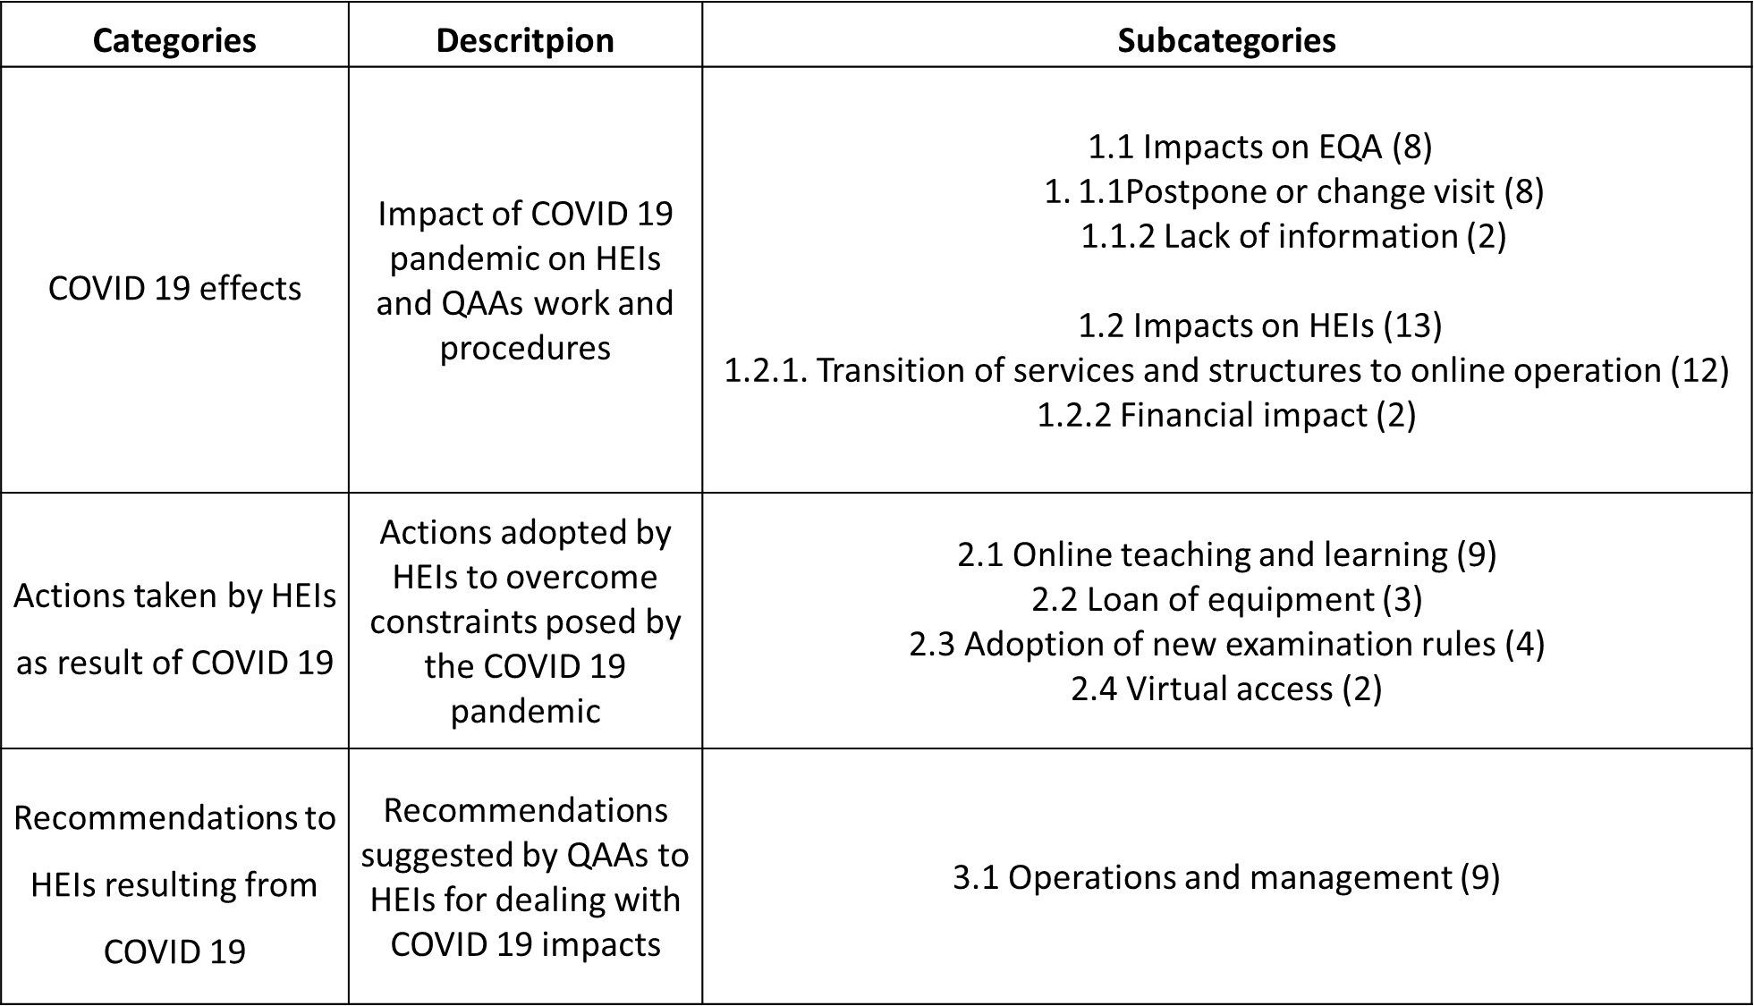
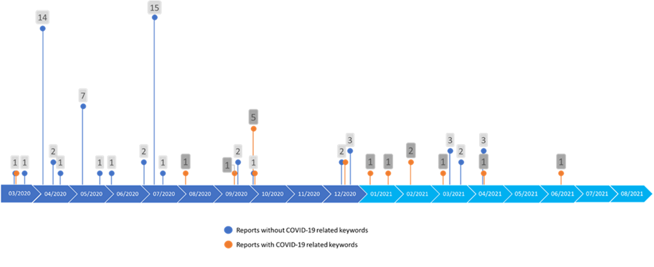
Results and preliminary conclusions
The content analysis of the 18 selected reports led to the identification of 3 main categories. Overall, it seems that QAA and HEIs were fast in adapting to online operation in order to continue their work, despite a number of challenges both QA and HEIs had to overcome

Slide 7
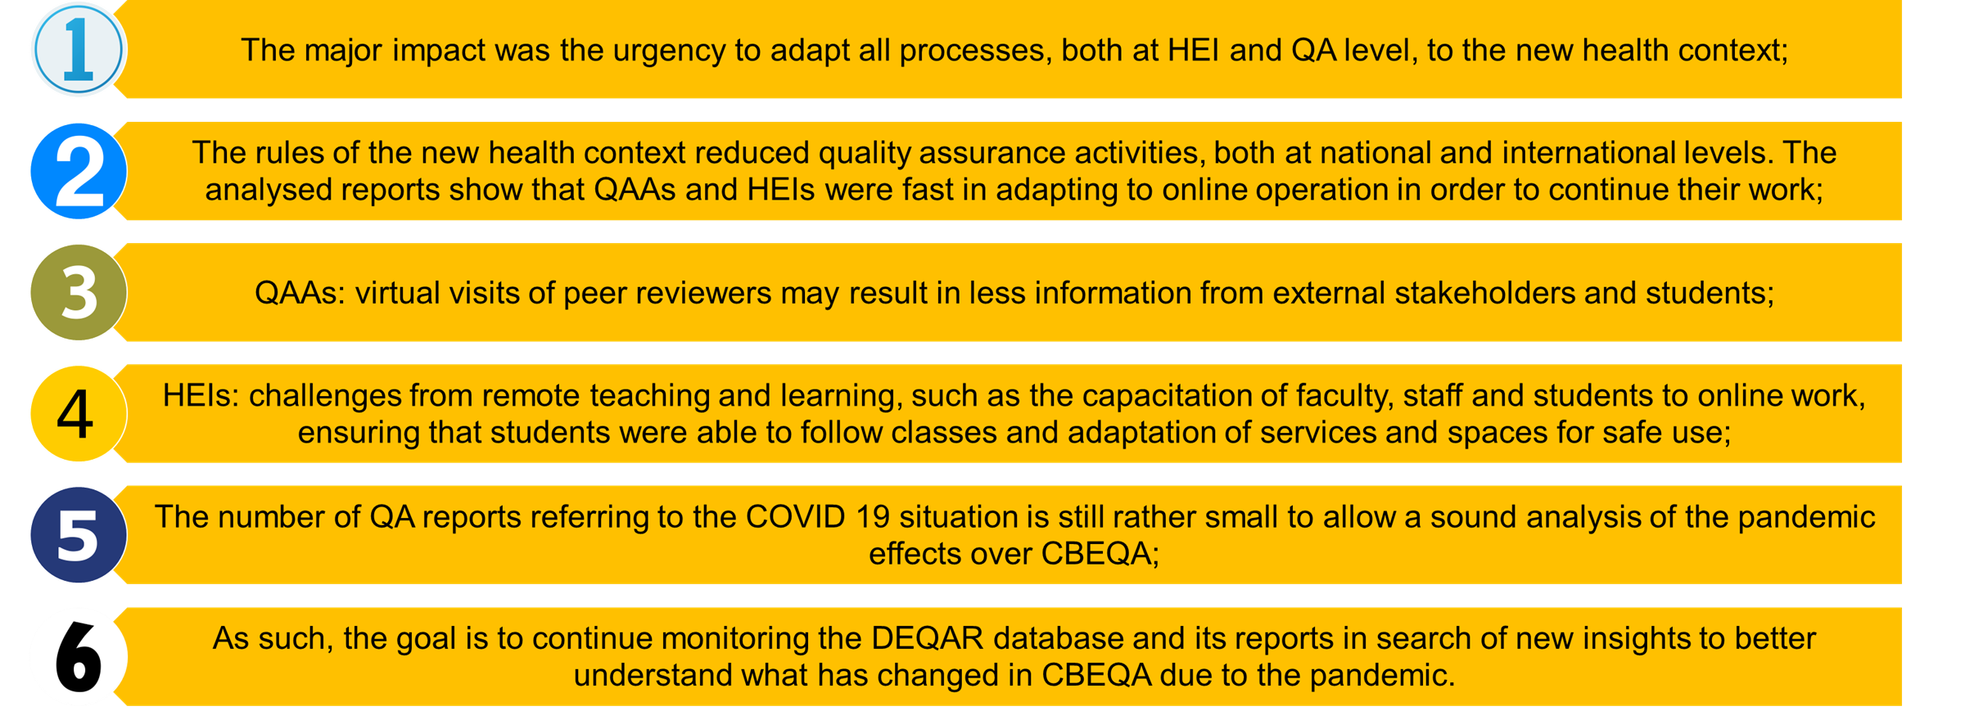
Results and preliminary conclusions

Slide 8
Questions to guide the discussions
Why the number of CBEQA reports has decreased less, when this type of QA activity implies crossing borders between countries and regions, which became far more difficult with the pandemic?
Is there a significant delay between the conclusion of the peer review report and its submission to DEQAR? Does this mean that reports made during the pandemic are still absent from the database?
Was the methodology to select the sample adequate (use of covid-19 related keywords)? Is it possible that the low number of covid-19 references in the reports is consequence of the normalisation of the pandemic context?

Slide 9
References
Amaral, A., Tavares, O., Cardoso, S., & Sin, C. (2016). Shifting Institutional Boundaries Through Cross-Border Higher Education. Journal of Studies in International Education, 20(1), 48–60.
Coutinho, C. (2016). Metodologia da investigação em Ciências Sociais e humanas – teoria e pratica. Lisboa: ALMEDINA.
ENQA, ESU, EUA, EURASHE, & EQAR. (2017). Key Considerations for Cross-Border Quality Assurance in the European Higher Education Area. Brussels.
Hou, A. Y.-C., Morse, R., & Wang, W. (2017). Recognition of academic qualifications in transnational higher education and challenges for recognizing a joint degree in Europe and Asia. Studies in Higher Education, 42(7), 1211–1228;
Sahu P. (2020) Closure of Universities Due to Coronavirus Disease 2019 (COVID-19): Impact on Education and Mental Health of Students and Academic Staff. Cureus, 12(4): e7541.
Stella, A. & Woodhouse, D. (2010) International Accreditation in Higher Education. In: Peterson, P., Baker, E. & McGaw, B. (Eds.). International Encyclopedia of Education (p.533-539). Elsevier.
Trifiro, F. (2018). Inter-agency cooperation in the quality assurance of transnational education: challenges and opportunities. Quality in Higher Education, 24(2), 136–153.

